Slide 1
Legacy Cities
COMMUNITY OF PRACTICE

Slide 2
The Legacy Cities Community of Practice is a year-long virtual fellowship that brings interdisciplinary teams from four cities together for:
peer learning;
insights from expert faculty; and
resources and support to tackle entrenched citywide policy issues with place-based project approaches.

Slide 3
Why a Community of Practice now?
It has been a challenging year for cities across the country and particularly for legacy city leaders as they navigate the COVID-19 pandemic and economic recovery. That’s why we’re launching a 13-month Community of Practice. We will build on the research, resources, and network of the broader Legacy Cities Initiative and facilitate shared learning. Our aim is to achieve an equitable recovery in a small group of committed legacy cities.
Cities are leading innovation in the United States. In particular, change-makers in legacy cities are tackling the hardest challenges we face today:
stubborn housing shortages;
inadequate transportation infrastructure and systems;
deep racial disparities;
economic inequities; and
the climate crisis.

Slide 4
Who is this program for?
We seek legacy cities that:
have a population of at least 50,000;
have sustained a decline of at least 20 percent from its peak historic population level; and
have a poverty rate higher than the national average.
We also welcome applications from cities that do not explicitly meet all of these criteria, but still identify as a “legacy city” and would like to be involved in the Community of Practice.
Please reach out to Jess Wunsch at jwunsch@lincolninst.edu if you have questions regarding eligibility.

Slide 5
Why legacy cities?
Legacy cities have been at the center of some of America’s most historic achievements, and they possess a strong civic spirit and culture of innovation at a time when these qualities are most needed. These cities offer growth potential not only for families, businesses, and communities seeking a stable future—but also for the country as a whole.
Once drivers of industry and prosperity, legacy cities lost millions of residents and jobs in the 20th century due to a changing economy—but many of them are now on a path toward revitalization. Home today to nearly 17 million people and a collective economy of $430 billion, legacy cities share the potential for an inclusive, prosperous future.

Slide 6
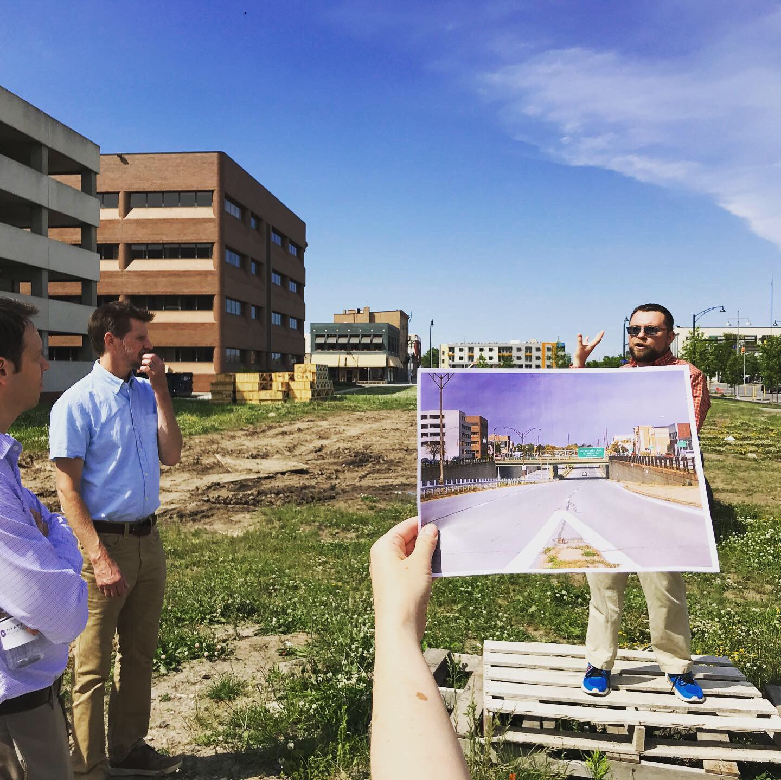
What is the Legacy Cities Initiative?
The Legacy Cities Initiative is a national network of community and government leaders working to create shared prosperity and bring attention to the common needs and collective importance of legacy cities. The initiative promotes sustainable and equitable revitalization by convening networks, facilitating the exchange of ideas and practices, and researching and advancing new policy approaches.

Slide 7
Why should my city be a part of this?
Each city team in the Community of Practice will:
gain insights from individual coaching sessions with faculty experts;
learn from national experts on issues facing Legacy Cities;
forge lasting collegial relationships with their counterparts in other legacy cities facing similar issues;
build intra-team, interdisciplinary relationships with other people on your city’s team;
create the space to undertake a new approach to a long-running, citywide policy issue; and
receive up to $10,000 towards a place-based project that brings a new approach to a citywide policy focus area.

Slide 8
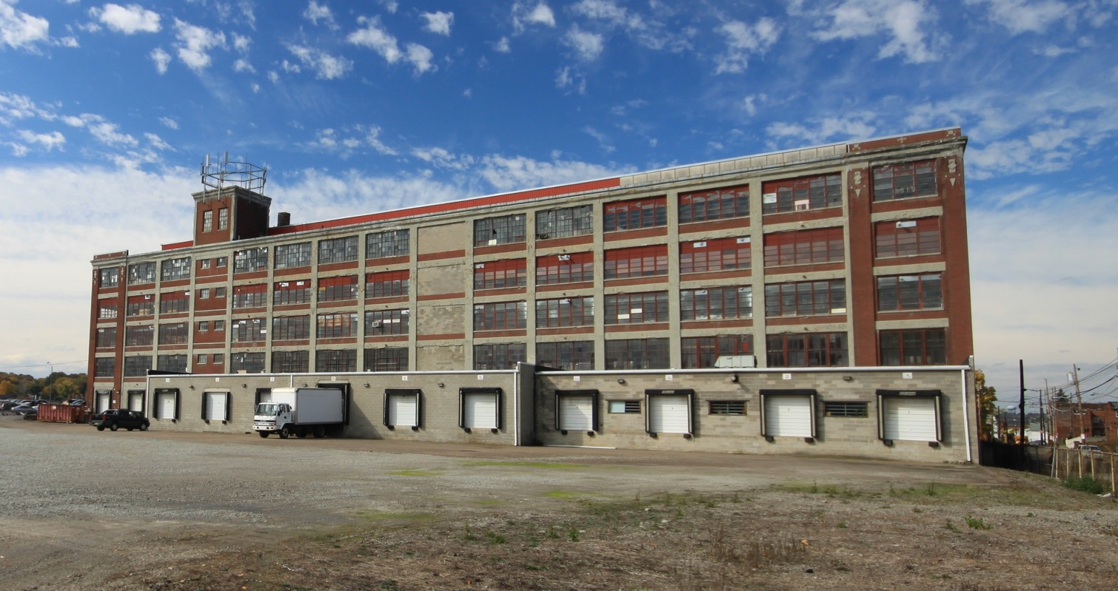
program description

Slide 9
How is this program unique?
Our approach differs from traditional convenings that limit the audience to city staff or community leaders.
Interdisciplinary
We believe that no single sector can accomplish change alone. Monthly, full-cohort sessions will convene 30⁠–⁠40 participants (in interdisciplinary teams representing four different U.S. legacy cities).
Peer-supported
While we are bringing both regular faculty and guest experts to the Community of Practice, we also presume that much expertise sits within the participants. City teams will choose a project that their peers will help them solve. Cities will also meet with each other to exchange ideas.
Project-focused
City teams will identify a policy focus area before the year begins to discuss with their peer cities and assembled experts. Each team will receive up to a $10,000 challenge grant towards a place-based project to pilot a new approach to the citywide issue.

Slide 10
Who from my city would participate?
We believe that coalitions of city staff and community and civic leaders are needed to drive positive change in Legacy Cities. As such, we suggest that each city identifies a team that includes four senior-level decision-makers.
Each team should include:
At least one person from within city government (likely someone from the mayor’s office or a head of a department such as planning, economic development, housing, or community development); and
At least one leader from a nonprofit community-based organization.
Other team members could include:
a leader from the county or another governmental entity;
a leader from a local or regional community foundation or CDFI; or
a leader of a local institution such as a hospital or university.

Slide 11
What kinds of cities and teams should apply?
We seek:
a coalitions of city staff and community and civic leaders that are poised to work together on a policy issue;
leaders who are powerful enough to make things happen within their cities, but able to focus on this project for a few hours a month; and
leaders who are open-minded and interested to learn how other communities approach problems, and who are interested in sharing their experiences with peers from other cities as well.

Slide 12
What will the city teams work on?
Before the year begins, each participating city will be asked to identify a citywide policy focus area, such as:
enacting participatory budgeting;
supporting small, minority-owned, or women-owned businesses after the recession;
stabilizing residential neighborhoods;
re-purposing office, retail, or industrial facilities.
During the Community of Practice year, each participating city implements a place-based project to their citywide policy focus area, such as:
research to understand vacancy rates in a particular neighborhood
community organizing and/or events to engage residents in the policy issue;
racial equity training for city staff, members of a neighborhood coalition, and other partners.

Slide 13
What will the year look like?
January
Introductory cohort call
Presentation and discussion on keeping equity in the foreground of your recovery
Monthly coaching session on scoping the policy focus
February
Presentation and discussion on centering community voice in setting government priorities
Monthly coaching session on brainstorming place-based approaches
Affinity group networking sessions: foundations, city staff, community-based organizations, etc.

Slide 14
What will the year look like?
March
Presentation and discussion on examples of place-based initiatives to pilot new approaches to citywide problems
Monthly coaching session on drafting a scope of work for place-based project
Paired city peer exchange session to connect on relevant pilot projects
April
Presentation and discussion on aligning capital behind your plans
Monthly coaching session on getting city and community buy in for place-based project
Call with Lincoln Institute on challenge funding

Slide 15
What will the year look like?
May
Presentation and discussion on indicators, benchmarks, metrics: tools for accountability and tracking progress
Monthly coaching session
Paired city peer exchange session to connect on relevant pilot projects
NOTES:
Topics and plans for the June 2021⁠–⁠January 2022 sessions will be finalized at a later date so that we are able to respond to the concerns of cities in the cohort.
There will be no monthly meetings in August 2021.

Slide 16
project team

Slide 17
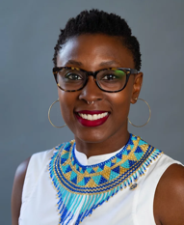
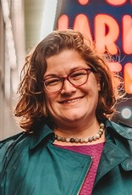
Who would I be working with?
The Community of Practice Faculty Mentors will share their expertise with the participants as they seek to address tough challenges around equitable revitalization in their places and work with two of the four cities each to help them advance their projects between full cohort meetings.
Bernadette Onyenaka | Jess Zimbabwe
O+G Racial Equity Collaborative | Plot Strategies

Slide 18
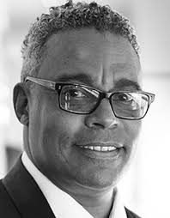
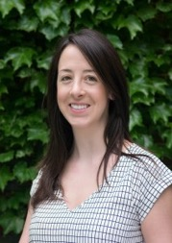
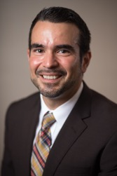
Who would I be working with?
The Community of Practice Faculty will share their expertise with the participants as they seek to address tough challenges around equitable revitalization in their places.
Charles Cross | Jenna DeAngelo | Carlos Delgado
Detroit Collaborative Design Center | Lincoln Institute of Land Policy | PolicyLink

Slide 19
Who would I be working with?
The Community of Practice Staff will facilitate monthly meetings, recruit guest experts, research policy ideas, manage communications and the learning network, and generally support participating city teams and faculty.
Jessie Grogan | Jess Wunsch
Associate Director of Reduced Poverty and Spatial Inequality, Lincoln Institute of Land Policy | Research Assistant, Lincoln Institute of Land Policy

Slide 20
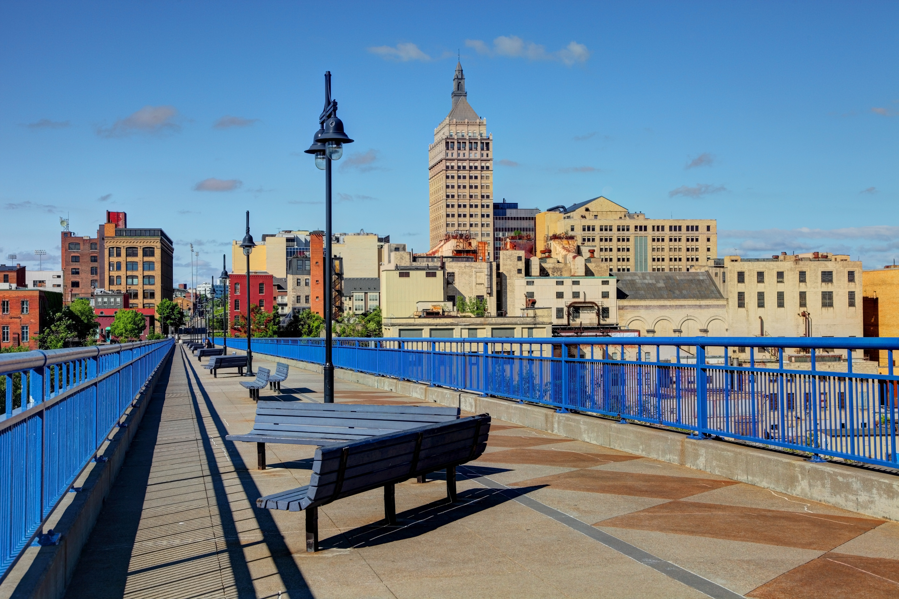
join us!

Slide 21
How do I get involved?
To express interest in joining the community of practice, please complete the short “Request for Expressions of Interest” form here.
We are evaluating responses on a rolling basis, and we will schedule a follow up call after we receive your answers.
We will update this webpage when we have filled the cohort.
Please reach out to Jess Wunsch at jwunsch@lincolninst.edu with any questions.

