Slide 1
Understanding Quantitative and Qualitative Analysis for Sales Adjustments in an Appraisal
By Michael Ellis, MAI

Slide 2
Sources of the Data Presented
• Various Appraisal Institute publications including:
a) The Appraisal of Real Estate, 14th Edition
b) The Dictionary of Real Estate Appraisal, 5th Edition.
(The 6th Edition will be coming out in either
October or November of 2015).
c) Advanced Sales Comparison and Cost Approach.
d) The Appraisal Journal, Fall 2014 - Article entitled,
Qualitative Analysis in the Sales comparison
Approach Revisited, by Gene Rhodes, MAI
• Personal Experience and discussions with various
appraisers and attorneys.

Slide 3
Goals
• To identify the various quantitative and qualitative
techniques available.
• Provide examples of these techniques.
• To provide some parameters as to their appropriate use.
• Introduce a new technique.
• Have a little fun on a late Friday afternoon.

Slide 4
Definitions:
Appraisal
1. The act or process of developing an opinion of value.
2. An opinion of value.
Source: The Dictionary of Real Estate Appraisal, 5th Edition, page 10. The Appraisal Institute.
Comparative analysis
The process by which a value indication is derived in the sales comparison approach. Comparative analysis may employ quantitative or qualitative techniques, either separately or in combination.
Source: The Appraisal of Real Estate, 14th Edition, by the Appraisal Institute. Page 397

Slide 5
Definitions:
Quantitative adjustment
In the sales comparison approach, the process of making numerical adjustments to the sales price of comparable properties including data analysis techniques (paired data analysis, grouped data analysis, and secondary data analysis), statistical analysis, graphic analysis, trend analysis, cost analysis (cost-to-cure, depreciated cost), and capitalization of rent differences; usually precedes qualitative analysis.
Source: The Dictionary of Real Estate Appraisal, 5th Edition, page 156. The Appraisal Institute.
Qualitative analysis
The process of accounting for differences (such as between comparable properties and the subject property) that are not quantified; may be combined with quantitative analysis.
Source: The Dictionary of Real Estate Appraisal, 5th Edition, page 156. The Appraisal Institute.

Slide 6
Typical Units of Comparison
Property Type | Typical Units of Comparison
Single family residential property | Total property price. Price per square foot of gross living area.
Apartment properties | Price per apartment unit. Price per room or per bedroom. Price per square foot of gross building area. Price per finished square foot of building area. Price per net square foot of building area.
Warehouses | Price per square foot of gross building volume. Price per truck door. Price per square foot of building area.
Factories | Price per square foot of gross building area.
Office properties | Price per square foot of gross building area. Price per square foot of rentable area. Price per square foot of usable area.

Slide 7
Typical Units of Comparison
Property Type | Typical Units of Comparison
Hotels and motels | Price per guest room
Restaurants, theaters, and auditoriums | Price per seat. Price per square foot.
Hospitals | Price per square foot of gross building area. Price per bed.
Golf courses | Total revenue multiplier. Golf revenue multiplier. Price per round (annual # of rounds played). Price per membership. Price per hole. Greens fee and rounds multiplier.
Tennis and racquetball facilities | Price per court.
Mobile home parks | Price per parking pad.
Marinas | Price per lineal foot. Price per linear foot.

Slide 8
Typical Units of Comparison
Property Type | Typical Units of Comparison
Automobile repair facilities | Price per slip. Price per linear foot.
Agricultural properties | Price per acre. Price per animal unit (for pastureland). Price per board foot (for timber).
Vacant land | Price per front foot. Price per square foot. Price per acre. Price per buildable square foot. Price per buildable unit.

Slide 9
Basic Elements of Comparison
The basic elements of comparison that should be considered in the Sales Approach include the following:
Basic Element | Details
real property rights conveyed | fee simple estate, leased fee interest, leasehold interest.
financing terms - i.e., cash equivalency | all cash, market financing, seller financing, special or atypical terms.
conditions of sale - ie., motivation | short sale, bank-owned real estate (REO), other.
expenditures made immediately after purchase | such as new roof, renovation cost.
market conditions | changes in supply and demand.
location | interior or corner lot, waterfront, proximity to value enhancing or value detracting issues.

Slide 10
Basic Elements of Comparison
The basic elements of comparison that should be considered in the Sales Approach include the following:
Basic Element | Details
physical characteristics | size, soils, access, construction quality, condition.
economic characteristics | expense ratios, lease provisions, management, tenant mix.
legal characteristics | zoning, environmental regulations, building codes, flood zones, deed restrictions.
non-realty components of value | personal property, furniture, fixtures, and equipment (FF & E), franchise, trademarks.

Slide 11
Traditional Types of Analysis
Quantitative Analysis | Qualitative Analysis
Paired data analysis (sales and resales of the same of similar properties). | Trend Analysis
Grouped data analysis. | Relative comparison analysis
Secondary analysis. | Ranking Analysis
Statistical analysis including graphic analysis and scenario analysis.
Cost-related adjustments (cost to cure, depreciated cost).
Capitalization of income differences.
Source: The Appraisal of Real Estate, 14th Edition, by the Appraisal Institute. Page 390

Slide 12
Example of Matched Pairs Analysis
Globe Building

Slide 13
Example of Matched Pairs Analysis
 | Globe Building | Identical Building
Net Rentable Area | 58,000 sf | 58,000 sf
Age / Condition | Built 1888 / Good | Built 1888 / Good
FAR Ratio | 6.99 to 1.0 | 6.99 to 1.0
Parking | None | 193 spaces
Sale Date | July 10, 2014 | July 10, 2014
Price | $3,300,000 | $5,730,000
Price Per NRA | $56.90 | $98.79
 | $5,730,000 - $3,300,000 = $2,430,000 $2,430,000 / 193 parking spaces = $12,591 per parking space

Slide 14
Grouped Matched Pair Abstraction - Example 2
 | Globe Building | Building 1 | Building 2 | Building 3 | Building 4
Net Rentable Area | 58,000 sf | 58,000 sf | 58,000 sf | 58,000 sf | 58,000 sf
Age / Condition | Built 1888 / Good | Built 1888 / Good | Built 1888 / Good | Built 1888 / Good | Built 1888 / Good
FAR Ratio | 6.99 to 1.0 | 6.99 to 1.0 | 6.99 to 1.0 | 6.99 to 1.0 | 6.99 to 1.0
Parking | None | 193 spaces | 290 spaces | 232 spaces | 157 spaces
Sale Date | July 10, 2014 | July 10, 2014 | June 30, 2014 | August 1, 2014 | August 27, 2014
Price | $3,300,000 | $5,730,000 | $6,550,000 | $6,015,000 | $5,380,000
Price Per NRA | $56.90 | $98.79 | $112.93 | $103.71 | $92.76
Parking Ratio |  | 1 space per 300 sf | 1 space per 200 sf | 1 space per 250 sf | 1 space per 370 sf
Contributory Value of One Parking Space |  | $12,591 | $11,207 | $11,703 | $13,248

Slide 15
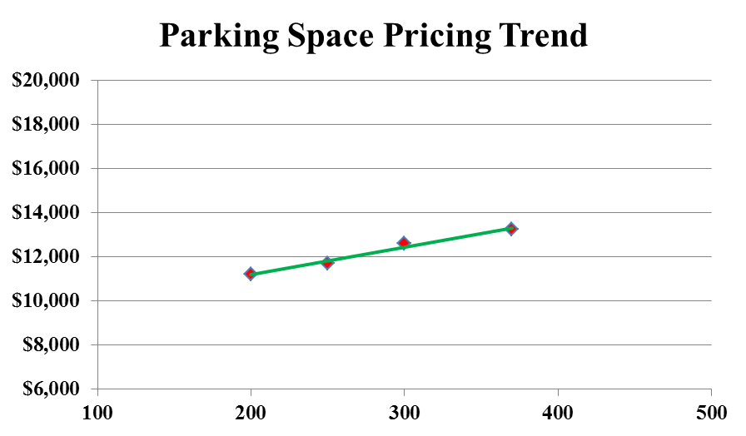
Arrayed visually by size and graphically the following trends emerge.
 | Sale 2 | Sale 3 | Sale 1 | Sale 4
Parking Ratio – NRA per Parking Space | 200 | 250 | 300 | 370
Contributory Value of One Parking Space | $11,207 | $11,703 | $12,591 | $13,248

Slide 16
DAVID STOTT BUILDING - DETROIT
Sale 1 | Sale 2
Sold – October 17, 2013 | Sold – May 8, 2015
$9,400,000 | $14,900,000
$44.89 psf | $71.15 psf
 | Seriously damaged since early sale

Slide 17
Continuing……
Let’s look at some additional information.
a) The rate of change between the two sale dates (17 ½ months) was 3.3% per month, or 40% annually.
This rate does not account for the change in property condition between the two sale dates.
If accounted for the indicated percentages increase.
b) The building is a 35-story Art Deco structure that was completed in 1929.
c) It contains a gross area of 209,410± sf.
d) Site area is approximately 83.8 feet by 71.25 feet, containing 5,840± sf.
e) FAR ratio (Floor Area Ratio) = 35.86 to 1.0. The building also has three levels below grade.
f) The property does not include parking and there are no property rights that include access to parking.
Parking decks typically sell in the CBD for between $9,500 and $16,000 per space.
In this location a reasonable estimate for this illustration is $12,500 per space.
Assuming one space for every 300 sf of building area results in a parking need of 698 spaces, or an
additional cost of 8,725,000 ($41.66 psf).

Slide 18
Secondary Analysis
A third type of data analysis is referred to as Secondary Analysis. This technique makes
use of data that does not directly pertain to the subject or comparable properties. “
This secondary data describes the general real estate market and is usually collected by
a data vendor research firm or government agency like the county assessor.”
– Sources of this type information include the following:
1. CoStar.
2. County or local assessor.
3. Local Realtors multi-list data system reports.
4. Brokerage market reports
5. Loop Net.
6. Market studies prepared by various professional organizations.

Slide 19
Secondary Analysis
Caution
1. The appraiser is responsible for understanding how the report
conclusions were obtained. Many appraisers are not aware what data
is included. Does it include both sale (leasing) and listing (asking)
prices.
2. Secondary sources frequently have erroneous information.
3. The secondary information may not apply for the appraiser(s) situation.
4. Secondary reports may include bias.

Slide 20
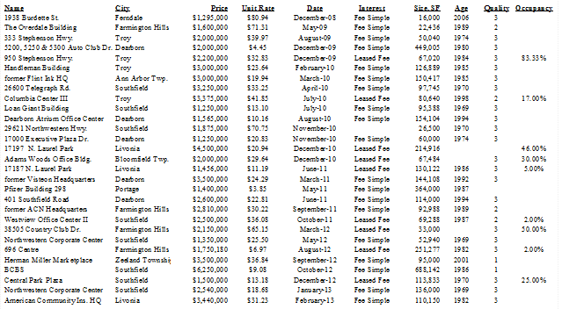
Statistical Analysis including Graphic Analysis

Slide 21
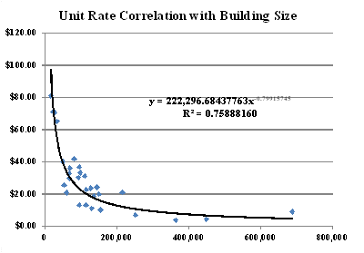
Statistical Analysis including Graphic Analysis
Coefficient of determination
In statistics, the coefficient of determination, denotes R²or r² and is pronounced R
squared, is a number that indicates how well data fit a statistical model - sometimes
simply a line or a curve. The closer R² is to 1.0, the more reliable the data.

Slide 22
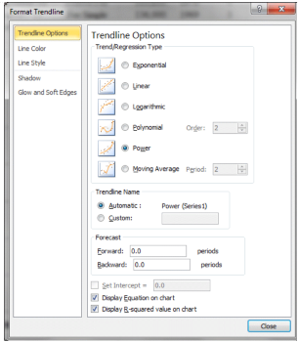
Statistical Analysis including Graphic Analysis

Slide 23
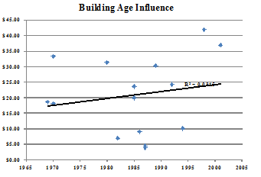
Statistical Analysis including Graphic Analysis
Sometimes statistical analysis can be utilized to evidence that a factor may have
less impact on a property’s value than might otherwise be expected. Provide below
is an example illustrating this condition for an office building age influence. The
resulting R² factor of 0.0315 means that there is little correlation with age in this
instance.

Slide 24
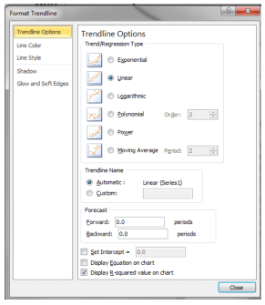
Statistical Analysis including Graphic Analysis
The trendline type utilized in the example above is referred to as a linear trendline.
When created on the spreadsheet the screen utilized will look as follows. You should
also see that a box is checked that states - Display R-squared value on chart. By
testing the various types of trendlines you may find that another type better reflects
market conditions.

Slide 25
Cost-related adjustments (cost-cure, depreciated cost)
• In cost analysis, adjustments are based on cost indicators such as depreciated building cost,
cost to cure, or permit fees. Costs-related adjustments are most persuasive in markets with
limited sales activity. The appraiser should be able to provide market support for cost-related
adjustments because cost and value are not necessarily synonymous.
• The adjustment for expenditures made immediately after purchase in the evaluation of a
property.
Source: The Appraisal of Real Estate, 14th Edition, page 401.

Slide 28
Capitalization of Income Differences
 | Globe Building | Building 1 | Building 2 | Building 3 | Building 4
Net Rentable Area | 58,000 sf | 58,000 sf | 58,000 sf | 58,000 sf | 58,000 sf
Age / Condition | Built 1888 / Good | Built 1888 / Good | Built 1888 / Good | Built 1888 / Good | Built 1888 / Good
FAR Ratio | 6.99 to 1.0 | 6.99 to 1.0 | 6.99 to 1.0 | 6.99 to 1.0 | 6.99 to 1.0
Parking | None | 193 spaces | 290 spaces | 232 spaces | 157 spaces
Sale Date | July 10, 2014 | July 10, 2014 | June 30, 2014 | August 1, 2014 | August 27, 2014
Price | $3,300,000 | $5,730,000 | $6,550,000 | $6,015,000 | $5,380,000
Price Per NRA | $56.90 | $98.79 | $112.93 | $103.71 | $92.76
Parking Ratio |  | 1 space per 300 sf | 1 space per 200 sf | 1 space per 250 sf | 1 space per 370 sf
Contributory Value of One Parking Space |  | $12,591 | $11,207 | $11,703 | $13,248
Net Operating Income Per Net Rentable Sq. Ft. | $5.69 psf | $9.86 psf | $11.25 psf | $10.42 psf | $9.28 psf
% Difference from Globe Building |  | 57.7% | 50.6% | 54.6% | 61.3%
Adjusted SF Unit Rate |  | $57.01 | $57.12 | $56.63 | $56.88
Adjusted Value |  | $3,306,559 | $3,312,814 | $3,284,681 | $3,298,778
The implied value range indicated is from $3,284,681 to $3,312,814, or about $3.3 million.

Slide 29
Personal Interviews
The following statement is provided in The Appraisal of Real Estate, 14th Edition on page 402. I strongly
agree with this statement.
“Personal interviews are part of the foundation of the adjustment process. That is, they can reveal the
opinions of knowledgeable individuals participating in the subject’s market such as trends in sale prices.
Although data gathered through personal interviews is primary data, the opinions of market participants,
however valuation, should not be used as the sole criterion for estimating adjustments or reconciling value
ranges if an alternative method that relies on direct evidence of market transactions can be applied.”

Slide 31
Trend Analysis
A qualitative technique used to identify and measure trends in the sale prices of comparable properties; useful when sales data on highly comparable properties is lacking, but a broad database on properties with less similar characteristics is available. Market sensitivity is investigated b testing various factors that influence sale prices.
Relative Comparison Analysis
A qualitative technique for analyzing comparable sales; used to determine whether the characteristics of a comparable property are inferior, superior, or similar to those of the subject property. Relative comparison analysis is similar to paired data analysis, but quantitative adjustments are not derived.

Slide 32
Ranking Analysis
A qualitative technique for analyzing comparable sales; a variant of relative comparison analysis in which comparable sales are ranked in descending or ascending order tof desirability and each is analyzed to determine its position relative to the subject.
Source of Definitions: The Appraisal of Real Estate, 14th Edition, pages 403 and 404.

Slide 33
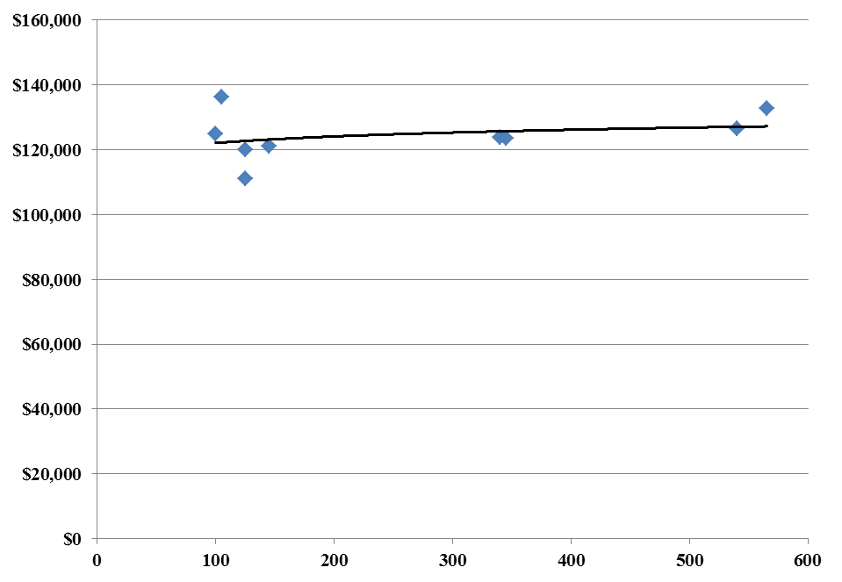
Trend Analysis
The Appraisal of Real Estate, 14th Edition states on page 403 that, “Trend analysis is applicable when a large amount of market data is available. Such analyses are often useful in a variety of applications. They are especially useful when there is a limited number of closely comparable sales but a large number of properties with less similar characteristics. The various elements of comparison influencing a sale price can be tested to determine their market sensitivity. Once the appraiser has determined which elements of comparison show market sensitivity, price patterns can be analyzed to support other analyses.”
Provided below are various examples of this type analysis. First shown are two graphs illustrating the effect of proximity to a transmission corridor.

Slide 34
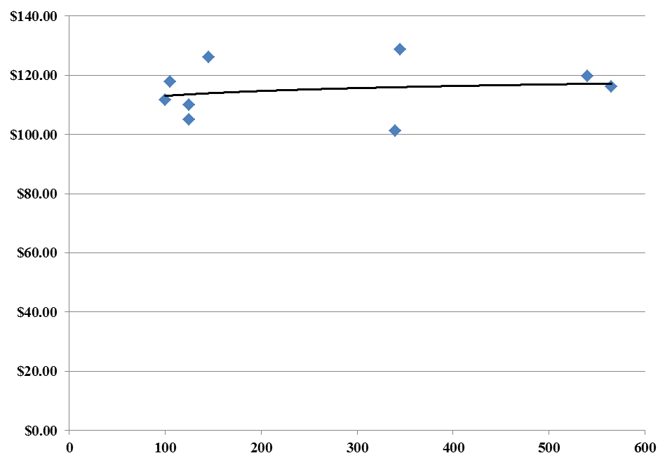
Trend Analysis
The two graphs reflect limited data, but tend to support that proximity to a transmission corridor has an adverse impact on value. Because each proximity situation is different the data only evidences that an impact occurs, not what the impact actually is.

Slide 35
Relative Comparison Analysis
“Relative comparison analysis is the study of the relationships indicated by market data without recourse to quantification, i.e., the data reveals an ordinal relationship between elements of a data set. Many appraisers use this technique because it reflects the imperfect nature of real estate markets. To apply the technique the appraiser analyzes comparable sales and identifies whether the characteristics of the comparable properties are inferior, superior, or similar to those of the subject property.”
Source: The Appraisal of Real Estate, 14th Edition, pages 403 and 404.

Slide 38
Cornice & Slate Building
Sold: August 9, 2013
$1,400,000, or $63.77 psf
24,000± nrsf

Slide 39
Globe Building
Sold: July 10, 2014
$3,300,000, or $56.90 psf
58,000± nrsf

Slide 40
Old County Building
Sold: August 27, 2014
$13,400,000, or $59.10 psf
226,750± nrsf

Slide 41
Marquette Building
Sold: August 27, 2014
$13,400,000, or $59.10 psf
164,000± nrsf

Slide 42
Hemmeter Building
Sold: September 2, 2015
$5,975,000, or $119.50 psf
50,000± nrsf

Slide 43
Woodbridge Building
Sold: September 30, 2015
$3,500,000, or $109.38 psf
32,000± nrsf

Slide 44
Conditions to be Considered

Slide 47
Summarized
 | Cornice & Slate | Globe Bldg. | Old County Bldg. | Marquette Bldg. | Hemmeter Bldg. | Woodbridge
Sale Date | 8/9/13 | 7/10/14 | 8/27/14 | 12/1/14 | 9/2/2015 | 9/2015
Sale Price | $1,400,000 | $3,300,000 | $13,400,000 | $5,775,000 | $5,975,000 | $3,500,000
Unit Rate Paid | $63.77 psf | $56.90 | $59.10 | $35.21 | $119.50 | $109.38
Overall Adjustment | Upward | Upward | Upward | Upward | Upward | Downward
Parking Adj. | $46 to $52 | $46 to $52 | $41.00 to $46.50 | $46 to $52 | $46 to $52 | $9.80 to $11.21
Adj. Unit Rate | $110 to $116 | $103 to $109 | $100 to $106 | $81 to $87 | $165 to $171 | $98 to $100
Other Adjustments | Upward | Upward | Equal | Upward | Downward | Downward
Observation: Parking spaces probably contributes less per sf when combined to an office building than as a free standing parking structure. If parking were adjusted at a lower unit rate per space, the range would tighten resulting in a valuation of the subject in the range of $100.00 per square foot.

Slide 48
Mathematics – w/o Parking
Assume | 232 | $11,500 | $2,668,000 | $46.00 psf
58,000 sf – bldg. | 232 | $13,000 | $3,016,000 | $52.00 psf
Mathematics - Old County Building | Bldg. SF | Parking Spaces | Parking Ratio
Old County Bldg. | 226,750 sf | 99 | 2,290 sf per space
Subject | 58,000 sf | 25 | 2,290 sf per space
 |  | 232 | 25 | 207 space advantage
 | 207 | $11,500 | $2,380,500 | $41.04 psf
 | 207 | $13,000 | $2,691,000 | $46.50 psf

Slide 49
Mathematics - Woodbridge | Building SF | Parking Spaces | Parking Ratio
Woodbridge | 32,000 sf | 155 | 206 sf per space
Subject | 58,000 sf | 283 | 206 sf per space
 |  | 232 | 282 | 50 space disadvantage
 | 50 | $11,500 | $569,864 | $9.83
 | 50 | $13,000 | $650,000 | $11.21

Slide 51
Ranking Analysis, continued
Quality Point is an expansion on techniques that have previously been presented in the Appraisal Journal and is described as a “price quality regression.” The technique is taught and extensively used in Canada and Australia, but has had limited exposure and use in the United States. Provided below is an example of what might be viewed when reviewing this type of presentation.

Slide 54
Land Valuation Maxtix
The following analysis represents a modified developmental technique. Included amongst the appraisal techniques applied are both subdivision development techniques and allocations. In addition, also present are elements of the direct sales comparison approach. Included amongst the principles present is that when a developer acquires property like the subject, the expectation of monetary gain is the primary motivation.
The technique holds that if you know the end price lots will sell for when they become available, and you also know the development cost per lot, market value on a per lot basis can also be abstracted. This methodology is also akin to the reverse of one of the techniques some developers employ when determining at what price they must sell lots, based upon the price they have paid for the raw land. The algebraic formula from the developers standpoint is as follows:

Slide 55
Land Valuation Matrix
Input Components
Lc = Raw Land Cost Paid Per Lot
HFl = Holding Factor Applied to Each Lot
TLc = Factor Resulting from Lc * HFl
DCl = Development Cost Per Lot
HC = Sum of TLc + DCl
PMc = Factor for Developer's Profit & Misc. Cost
∑ = Indicated Price Per Lot - 1st Year
FORMULA
Lc * HFl = TLc
TLc + DCl = HC
HC * PMc = ∑
or
((Lc * HFl) + DCl) * PMc = ∑

Slide 56
Land Valuation Matrix
Reversing the procedure for the same formula provided above, an appraiser can determine what unit rate per lot is indicative of economic market conditions. The result of this determination factored by the total number of lots planned for a development provides an indication as to a property's market value. The algebraic formula for this technique is as follows:
(1/PMc - DCl) - 1/HFl = Lc

