Slide 1
Big-Box Valuation Methodology…
Dark vs Operating
Presented to
National Conference of State Tax Judges
Lincoln Institute of Land Policy
36th Annual Meeting
Portland, Oregon
September 9, 2016
Peter F. Korpacz, MAI, CRE, FRICS
Founder & President
Korpacz Realty Advisors, Inc.
pkorpacz@korpaczra.com

Slide 2
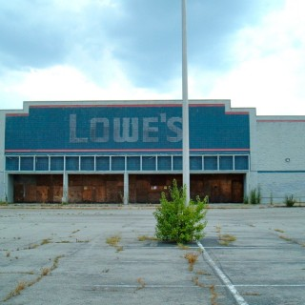
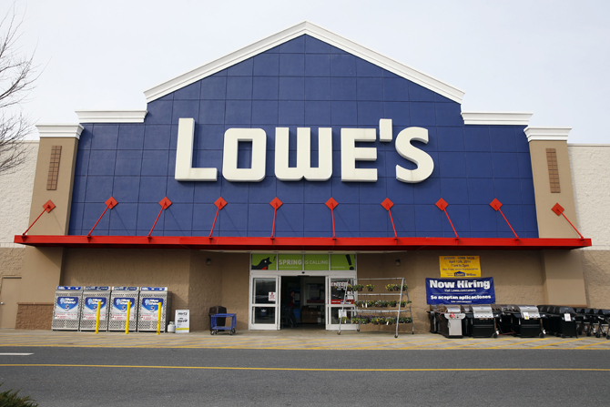
Contents
The Problem
Big-Box Retailers’
Tax Appeal Arguments
Definitions
Question Needing an Answer
Valuation Methodology Sources
Proposed Valuation Methodology
Korpacz Realty Advisors, Inc.

Slide 3
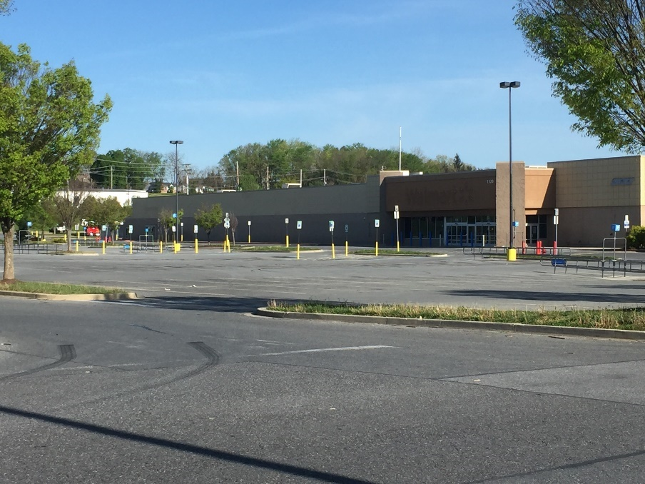
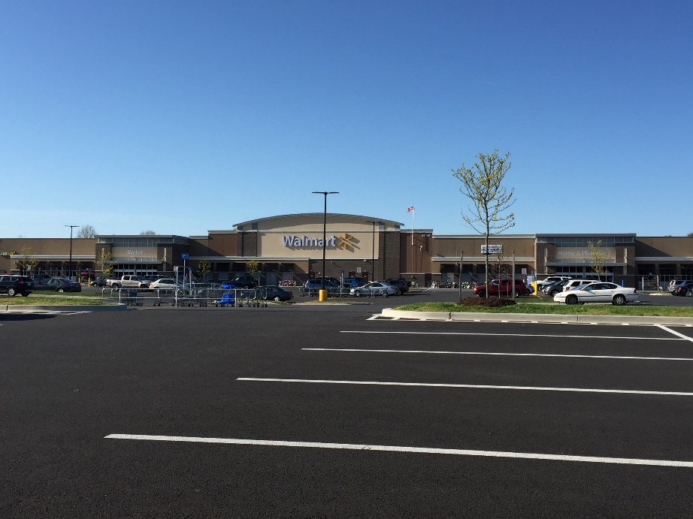
The Essence of the Problem
Dark Store
Do they have the same highest & best use?
Are they worth the same (assuming similar size)?
Should appraiser use the same comps for both valuations?
Former Walmart
Former Walmart
Operating Store
New
Walmart
Nearby
New Walmart
New Walmart
Korpacz Realty Advisors, Inc.

Slide 4
Big-Box Retailers’ Tax Appeal Arguments
Korpacz Realty Advisors, Inc.

Slide 5
The Dark Store Theory Argument
Fee simple value is best reflected by sales of vacant big-box stores because those properties are not encumbered by leases.
Korpacz Realty Advisors, Inc.

Slide 6
Dark Store Theory Facts
They provide reasonable comps for similar unoccupied or soon to be vacant properties.
Dark store sales usually reflect poorly performing locations.
The debate centers on whether a dark store sale
  Reflects the same highest and best use of a seemingly successful operating store, and
  Can be used to value a property occupied by a seemingly successful operating store
Korpacz Realty Advisors, Inc.

Slide 7
Value-in-Use Argument
Considering the business success of an operating store results in value-in-use, not value-in-exchange
Korpacz Realty Advisors, Inc.

Slide 8
Value-in-Use Facts
Considering the retail sales performance of the existing tenant is useful in understanding demand at that location for that type of big-box use.
The retail sales should not be used to develop a market rent estimate employing a percentage rent calculation. That would be value-in-use.
Korpacz Realty Advisors, Inc.

Slide 9
Value-in-Use Facts (cont’d)
Value-in-use is not always different from value-in-exchange.
Use value and exchange value at market rent are only different when the current use is not the highest and best use.
When the appraiser concludes the current use is the highest and best use (not the specific user), the use and exchange values are the same.
Korpacz Realty Advisors, Inc.

Slide 10
Sale-Leaseback Argument
Retailers contend they involve transactions, where investors care more about the tenant than the real estate
They are driven by the credit of the tenant
And, these sales represent leased fee value, not fee-simple value.
Korpacz Realty Advisors, Inc.

Slide 11
Sale-Leaseback Facts
Retailer acquires the site or hires contractor to acquire the site and construct the store
Retailer pays contractor for all costs (including profit) and sells the entire property to an investor and leases back the property
Differs from traditional financing sale leaseback, where high-credit company sells an older, existing building and leases it back
Korpacz Realty Advisors, Inc.

Slide 12
Sale-Leaseback Facts (cont’d)
Property interest adjustment might be needed to reflect “leased fee” interest transferred
Concept of ”fee simple proxy” needs to be considered
A “fee simple proxy” is a comparable sale property whose contract rent and net operating income (NOI) is approximately equal to market rent and NOI.
Korpacz Realty Advisors, Inc.

Slide 13
Sale-Leaseback Facts (cont’d)
Sale may or may not reflect both market rent and price
If it does, then the comparable sale represents a fee simple proxy, which can be used to value the property and other comparable properties
Sale verification process is key to confirming whether the sale can be treated as a fee simple proxy
Korpacz Realty Advisors, Inc.

Slide 14
Build-to-Suit Argument
They only reflect construction cost
And, do not represent arm’s-length transactions
Korpacz Realty Advisors, Inc.

Slide 15
Build-to-Suit Facts
All new real estate developments, whether build-to-suit for a specific tenant or for a type of speculative tenant, are freely negotiated to provide an economical price and rental for both parties.
The developer seeks a return of cost and a reasonable profit, and the tenant seeks the lowest rent consistent with the expected performance of the store.
Korpacz Realty Advisors, Inc.

Slide 16
Build-to-Suit Facts
When the rent is based on the developer’s cost and reasonable profit, that should represent “market rent”
If both parties negotiated in good faith and come to an agreement, that is evidence of market rent and property value
Market participants confirm the deal terms are meant to be at market for new construction
Korpacz Realty Advisors, Inc.

Slide 17
Same Highest & Best Use Argument
The highest and best use of a successful operating store in a fee simple valuation is no different than the highest and best use of a vacant and possibly abandoned store.
Does a vacant store reflect an operating, seemingly successful big-box location/operating store?
Korpacz Realty Advisors, Inc.

Slide 18
Highest and Best Use Facts
Dark store – second-generation use, i.e., furniture store, flea market, conversion to multiple tenants
Operating store –
  first generation use, if profitable
  second-generation use, if current use is no longer economically viable as continued first-generation use
Korpacz Realty Advisors, Inc.

Slide 19
Highest and Best Use Facts (cont’d)
Why is the current user overlooked as a potential user? It doesn’t reflect value-in-use but a likely user of the space if it were unoccupied.
Korpacz Realty Advisors, Inc.

Slide 20
Online Sales Competition Argument
Big-box stores are becoming obsolete because consumers are shifting to online shopping and the large big-box chains are shifting to a smaller store design
Korpacz Realty Advisors, Inc.

Slide 21
Online vs Brick and Mortar Facts
Korpacz Realty Advisors, Inc.

Slide 22
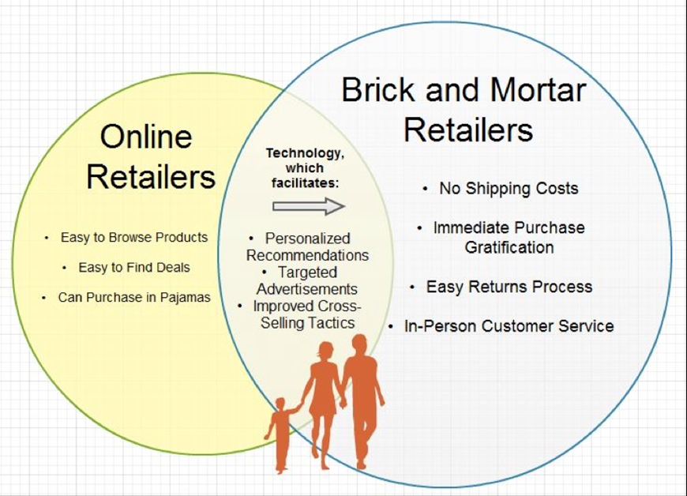
Online vs Brick and Mortar Facts
Korpacz Realty Advisors, Inc.

Slide 23
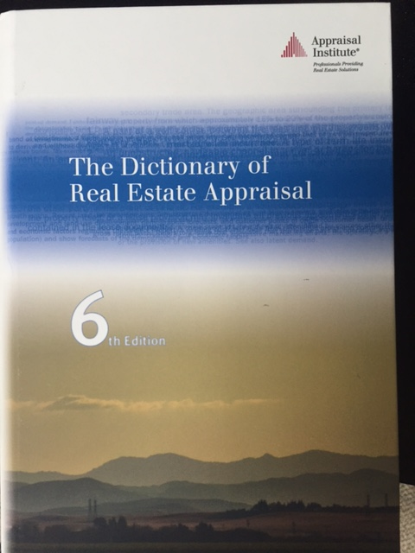
Definitions
Korpacz Realty Advisors, Inc.

Slide 24
Basic Definitions
Big-box (LEASING/RETAIL) – a single-use store, typically between 10,000 and 100,000 square feet or more, such as a large bookstore, office supply store, dark store, pet store, electronics store, or toy store⁽¹⁾
Other characteristics – high ceilings, minimal glass façade
⁽¹⁾ ICSC Dictionary of Shopping Centers, 2005, page 12 and Appraisal Institute’s The Dictionary of Real Estate Appraisal, Sixth Edition,
2015, page 22
Korpacz Realty Advisors, Inc.

Slide 25
Big-Box Definition is Evolving
Originally referred to as single-story, high ceiling structures
Some definitions now include multistory retail structure, such as department stores and larger size boxes
The definition is not the issue!
Korpacz Realty Advisors, Inc.

Slide 26
Big-Box Store Type Examples
Discount department stores – Walmart, Target, Meijer, Kohl’s
Specialty stores – Best Buy, Dick’s Sporting Goods, Office Depot, Lowe’s TJMaxx/Home Goods, PetSmart, Toys ‘R’ Us
Warehouse stores – Sam’s Club, Costco, BJ’s
Korpacz Realty Advisors, Inc.

Slide 27
Definitions that Cause Problems/Confusion
“Market rent – the most probable rent that a property should bring in a competitive and open market reflecting the conditions and restrictions of a specified lease agreement, including the rental adjustment and revaluation, permitted uses, use restrictions, expense obligations, term, concessions, renewal and purchase options and tenant improvements TIs.”⁽¹⁾
The definition does not say that the property must be considered as an older structure, with significant functional and external obsolescence. For that matter, it does not say the property must be vacant.
⁽¹⁾ Appraisal Institute’s The Dictionary of Real Estate Appraisal, Sixth Edition, 2015, page 140
Korpacz Realty Advisors, Inc.

Slide 28
Definitions that Cause Problems/Confusion
First-generation space – a building or space designed to be functionally and economically efficient for the original tenant or a similar class of tenants over a period of time, during which the space retains its original utility and desirability.⁽¹⁾
⁽¹⁾ Appraisal Institute’s The Dictionary of Real Estate Appraisal, Sixth Edition, 2015, page 92)
Korpacz Realty Advisors, Inc.

Slide 29
Definitions that Cause Problems/Confusion
Second-generation space – a building or space used by a tenant other than the original tenant; often functionally obsolete before refurbishment but sometimes containing tenant improvements that can be reused by a new tenant.⁽¹⁾
Second-generation space – a building or space whose design is no longer functionally and economically efficient for the original tenant or a similar class of tenant. The space no longer retains its original utility and desirability and must now be used by a tenant other than the original tenant or similar class of tenant.⁽²⁾
Appraisal Institute’s The Dictionary of Real Estate Appraisal, Sixth Edition, 2015, page 210
Peter F. Korpacz, MAI, CRE, FRICS
Korpacz Realty Advisors, Inc.

Slide 30
Question Needing an Answer
Why is dark store (property) theory only used in reference to big boxes?
  What about office, shopping centers, industrial, and apartments?
  Reminds me of the push for intangible value components in malls in the 1990s.
  The Merle Hay case⁽¹⁾ captured the issue perfectly for malls.
  Who will resolve the big-box dilemma – the courts or state legislatures?
⁽¹⁾ Merle Hay Mall v City of Des Moines Bd. Of Review, 564 N.W. 2nd 419 (1997)
Korpacz Realty Advisors, Inc.

Slide 31

Valuation Methodology Sources
Korpacz Realty Advisors, Inc.

Slide 32
Implications of the Big-Box Theory
Would the dark store theory be applied to – office, malls, apartments, industrial, and hotel properties?
Improved vacant comparables would be hard to get but necessary
Massive quantity of reassessments would be required, at least initially
AM I MISSING SOMETHING?
Is there a solution that would be viewed as fair to both parties?
Korpacz Realty Advisors, Inc.

Slide 33
Sources of Valuation Methodology
Market behavior
  Verify each sale and confirm what was bought
  What was its highest and best use, and
  How was it priced
Real estate appraisal texts
Appraisal standards promulgated by The Appraisal Foundation Boards (esp. ASB and APB), and the Appraisal Institute, state laws regarding assessment rules and standards, assessor handbooks, etc.
Korpacz Realty Advisors, Inc.

Slide 34
What’s the Best Methodology Source?
There should be no surprise –
        MARKET BEHAVIOR
But, the why is very important
Korpacz Realty Advisors, Inc.

Slide 35
The Why Answers
Real estate transaction marketplace
  The foundation for “market” valuation methodology
  It trounces every other source
Texts
  Reflects opinions of the select few who write them and an even a smaller group who approve them
  They lag evolving market behavior methodology due to publication dates
Appraisal standard providers are relevant for general standard of practice but may not reflect detailed market-based valuation methodology
Korpacz Realty Advisors, Inc.

Slide 36
So What Does Market Behavior Tell Us
Common characteristics of big-box sale transactions⁽¹⁾
Operating stores with good trade area demographics and economics
Buyer is usually an investor (individual, group, fund, etc.)
Modern, relatively new improvements with tenant on a long-term lease with renewal options
First-generation space condition expected to continue for long term
Prices at high end of range
(Class A)
⁽¹⁾ Based on personal study by the author of sales of Walmart, Lowe’s Home Depot, Kohl’s, and Dick’s Sporting Goods over the last 2.5 years.
Korpacz Realty Advisors, Inc.

Slide 37
So What Does Market Behavior Tell Us
Common characteristics of big-box sale transactions⁽¹⁾
Operating stores with slow growth trade area trends
Aging improvements with design elements that do not meet current criteria of tenant
Lease expiring in 10± years with possible subsequent move out of existing tenant
Prices at mid level of range
(Class B)
⁽¹⁾ Based on personal study by the author of sales of Walmart, Lowe’s Home Depot, Kohl’s, and Dick’s Sporting Goods over the last 2.5 years.
Korpacz Realty Advisors, Inc.

Slide 38
So what does market behavior tell us
Common characteristics of big-box sale transactions⁽¹⁾
Prices at low end
of range (Class C
or D)
Vacant (dark) store or soon to be vacant
Poorly performing store expected to go dark over the near term
No interest for first-generation use and minimal interest for second-generation use, except at “bargain basement” prices
⁽¹⁾ Based on personal study by the author of sales of Walmart, Lowe’s Home Depot, Kohl’s, and Dick’s Sporting Goods over the last 2.5 years.
Korpacz Realty Advisors, Inc.

Slide 39
Other Market Behavior Findings
High priced sales
Highest and best use -
Comparable sales -
First-generation space.
The continuation of the property for a big-box user
Sales of properties that are leased to big-box tenants and bought by investors
Korpacz Realty Advisors, Inc.

Slide 40
Other Market Behavior Findings
Mid-level priced sales
Highest and best use -
Comparable sales -
Interim use until second-generation use becomes appropriate
Sales of properties with reasonably similar characteristics to investors or redevelopers
Korpacz Realty Advisors, Inc.

Slide 41
Other Market Behavior Findings
Low priced sales
Highest and best use -
Comparable sales -
Second-generation space
Sales of properties with reasonably similar characteristics, dark or soon-to-be dark
Korpacz Realty Advisors, Inc.

Slide 42

Proposed Valuation Solution
Korpacz Realty Advisors, Inc.

Slide 43
Proposed Valuation Methodology
Classify big-box properties similar to mall classifications
Analyze highest and best use, especially the demand component
Let highest and best use conclusion drive the proper selection of comparable sales
Use all three approaches to value despite limitations
Korpacz Realty Advisors, Inc.

Slide 44
Why Classify Big-Box Properties?
Helps determine highest and best use
Drives selection of appropriate comparable rentals and sales, i.e.
  Compares Class A subject property with Class A comps
  Same is true for Class B properties with Class B comps
  Compares Class C and D subject properties with Class C and D comps
Korpacz Realty Advisors, Inc.

Slide 45
Why Classify Big-Box Properties? (cont’d)
Result is market-supported opinions of market rents, cap rates, and prices per square foot that judges and juries could use to reach fair and equitable conclusions.
Korpacz Realty Advisors, Inc.

Slide 46
Highest and Best Use as Improved
Three possible conclusions ⎯
  Retain the existing property as if leased and occupied as first-generation space
  Assume the property is unoccupied or soon-to-be unoccupied and the improvements must be modified for use as second-generation space (dark store premise)
  Demolish the improvements and redevelop the site
Korpacz Realty Advisors, Inc.

Slide 47
Approaches to Value
Cost Approach –
  On existing stores
  On newly developed stores – use actual costs
Income Capitalization Approach –
  Use market rents, and
  Cap rates from comparable sales with similar classifications
Sales Comparison Approach –
  Use comparable sales with similar classifications
Korpacz Realty Advisors, Inc.

Slide 48
Fee Simple Problem can be Overcome
Two fee simple market value possibilities ⎯
  Fee simple as if leased and occupied at market rents and terms (fee simple proxy)
  Fee simple as if vacant or soon-to-be vacant (dark store)
Decision should be based on highest and best use conclusion for the property as improved
Korpacz Realty Advisors, Inc.

Slide 49
Contract vs. Market Rents Concept
Contract Rent Above Market
Cap Rate
Contract Rent
At Market
Contract Rent Below Market
The sales with contract rents at market become fee simple proxies.
Korpacz Realty Advisors, Inc.

Slide 50
Range of Cap Rates*
High end of range
little or no near-term growth in NOI and value
(above-market contract rents)
Midpoint (average)
typical near-term growth in NOI and value
(contract rents at market)
Low end of range
above-average growth in NOI and value
(below-market contract rents)
Which one is the fee simple proxy?
* Where contract to market rent ratio cannot be ascertained.
Korpacz Realty Advisors, Inc.

Slide 51
Implications of Proposed Solution
Above-average performing big-box properties (Class A) will receive the highest assessments
Average-performing big-box properties (Class B) will receive a mid-level assessment
Below-average performing big-box properties (Classes C and D) will receive the lowest assessments
Both sides will receive “half a loaf vs no loaf”!
Korpacz Realty Advisors, Inc.

Slide 52
Big-Box Valuation Methodology…
Dark vs Operating
Peter F. Korpacz, MAI, CRE, FRICS
Founder & President
Korpacz Realty Advisors, Inc.
3121 Glen Abbey Drive
Mount Airy, MD 21771
301.829.3770 (phone)
301.639.5694 (cell)
pkorpacz@korpaczra.com
www.korpaczra.com

